Slide 1

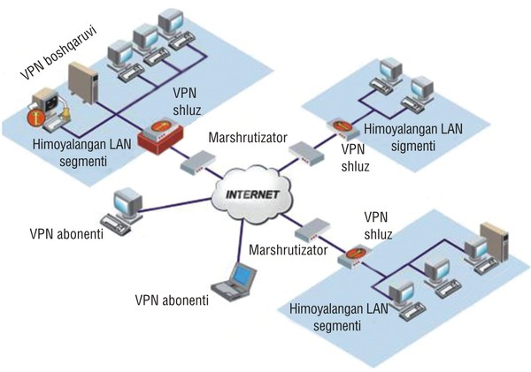
TARMOQ ADMINISTRATORLIGI 7-DARS

Slide 2


MS WINDOWS SERVERS 2012R2
ACTIVE DIRECTORY DOMAIN CONTROLLER

Slide 3
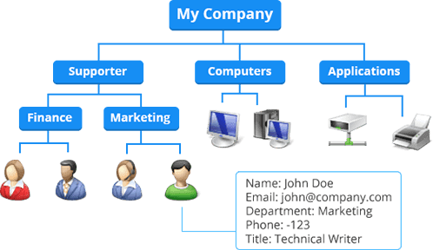

Slide 4
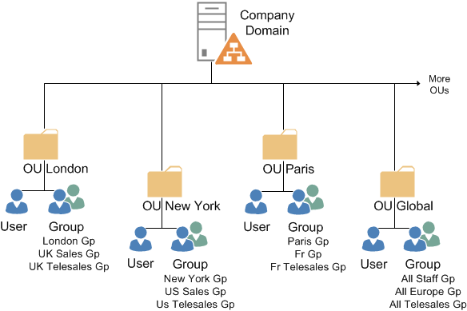
ACTIVE DIRECTORY DOMAIN CONTROLLER (ADDC)

Slide 5
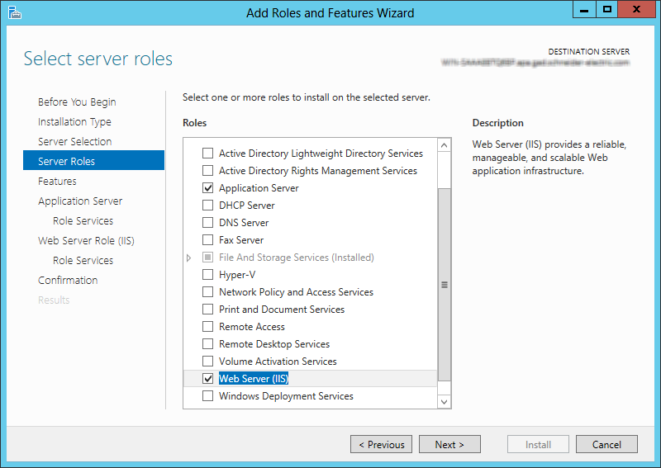
ADD ROLES AND FEATURES

Slide 6
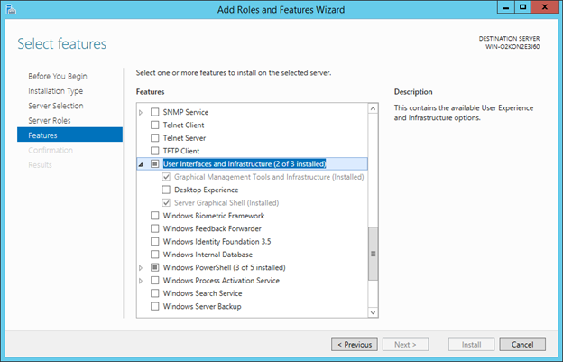
ADD ROLES AND FEATURES

Slide 7
ACTIVE DIRECTORY DOMAIN CONTROLLER (ADDC)
INSTALL ACTIVE DIRECTORY
(AD ni o’rnatish)
PROMOTE SERVER AS DOMAIN CONTROLLER
(DC ni sozlash)

Slide 8
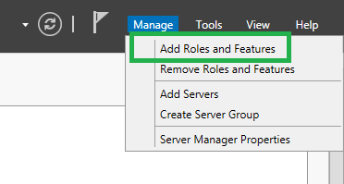
Install Active Directory

Slide 9
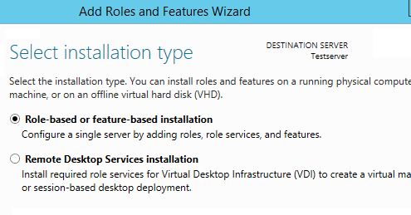

Slide 10
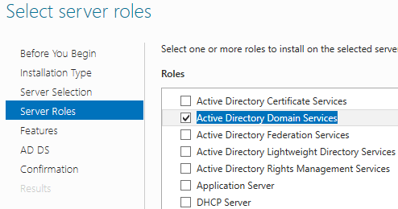

Slide 11
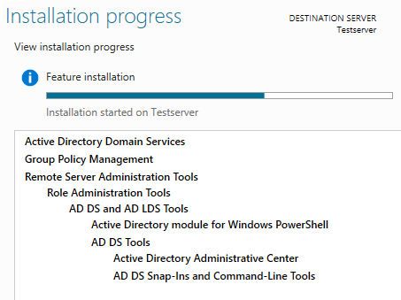

Slide 12
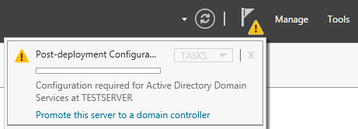
PROMOTE SERVER AS DOMAIN CONTROLLER

Slide 13
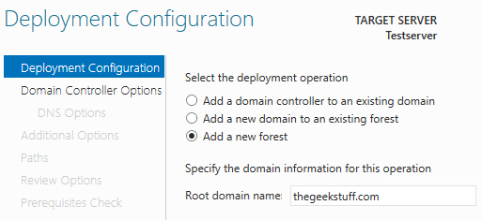

Slide 14
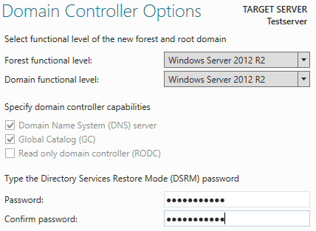

Slide 15
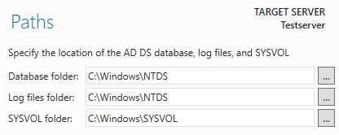

Slide 16
